Slide 1
ProAccess
Product Introduction
Fredy Kaufmann + FSC
10.10.2019

Slide 2
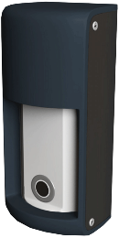
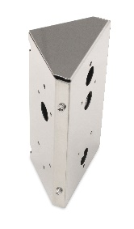
Product Overview
ProAccess is a vehicle detection sensor for gates and barriers
398522 ProAccess
Sensor
Accessory
399601 Bracket ProAccess
mounting bracket

Slide 3
Applications / Pricing

Slide 4
Applications
Barrier (entry)
Ticket dispenser with barrier activation and
Presence detection

Slide 5
Applications
Barrier (exit)
Activation and
Presence detection

Slide 6
Applications
Sliding gate
Exit activation and
Presence detection

Slide 7
Product details

Slide 8


Introduction
Detection logic of ProAccess
1)
2)
No detection,
no output signal.
vehicle detected (by microwave sensor),
ultrasonic sensor gets activated,
output signal on

Slide 9
Introduction
Detection logic of ProAccess
3)
4)
Parked vehicle
detection state maintained
Vehicle leaves detection area,
change to non-detection state

Slide 10


Technologies
Detection principle of ProAccess
Microwave
  Doppler to detect approach of a object
  FMCW (frequency modulated continuous wave) technology
  to keep presence of an object
Ultrasonic
  Can detect objects close to the sensor

Slide 11
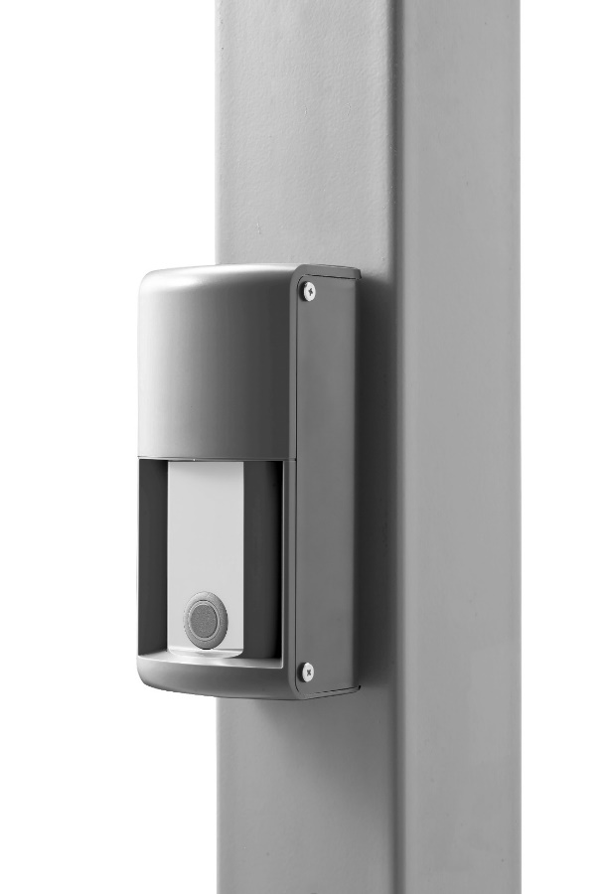
Algorithm of detection
Moving object detection
  Only larger objects (→ ignores people…)
  Once object detected
  → wakes up presence detection
Presence detection
0.8 – 5.5 m
Microwave module
Ultrasonic module
Presence detection
0.1 – 1 m
No moving object detected → no presence function

Slide 12
Product Specifications
Mechanical and environmental Data
Ambient temperature |  | -30 to 50°C
Operating ambient humidity |  | 95% max. (no condensation)
Protection class |  | IP65
Installation height |  | 500 mm (distance from the ground to the bottom of the unit)
Sensor angle adjustment |  | Left and right: ±30 degrees (5-degree steps)
Dimensions |  | 175 x 80 x 72.5 mm
Weight |  | 420 g
In the box |  | Retaining screws (4x), Operating instructions

Slide 13
Product Specifications
Electrical Data
Sensor technology |  | Microwave: 24 GHz, Ultrasonic: 56 kHz
Supply voltage |  | 12 - 24 VDC, ± 15 %
Response time |  | 500 ms
Power consumption |  | Heater disabled: Up to 80 mA (at 24 V) Heater enabled: Max. 200 mA (at 12 V)
Output |  | Relay output 30 VDC, 0.3A (N.O. / N.C. switchable)
Input |  | Active low / high, selectable
Sensing distance | Microwave sensor | 0.8 to 5.5 m (max. range adjustable)
 | Ultrasonic sensor | 0.1 to 1.5 m (max. range adjustable)
Detectable vehicle speed |  | 2 - 20 km/h

Slide 14
Product Specifications
Detection area diagram
Top view Side view
Microwave
Ultrasonic
3
2
1
0
1
0
1
2 m 3 m 5.5 m setting
2 m 3 m 5.5 m setting
ground
0 1 2 3 4 5 6 7
0 1 2 3 4 5 6 7
[m]
[m]

Slide 15
Installation

Slide 16
Placing
Recommendations
Barrier
Barrier arm
Vehicle path
700 mm
90°
90°
Secure side
Public side
150 mm
Ticket dispenser
Perpendicular Mode
Perpendicular Mode

Slide 17
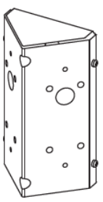
Placing
Recommendations
Sliding gate
Moving gate panel
700 mm
400 mm
700 mm
Vehicle path
90°
90°
45° or less
Public side
Secure side
100 mm
Hint:
use the 45° bracket
Perpendicular Mode
Angled Mode

Slide 18
Placing
Mounting height
Have more than 0.3 m distance to minimize the influence of the barrier arm!
> 0.3 m
0.5 m

Slide 19
Placing
Please adjust that the detection plane is parallel to the road surface. Some vertical adjustment maybe required if the road rises or falls away from the sensor’s mounting height.
or
Level
500 mm
500 mm
Uphill
500 mm
Shim
Shim
Downhill
500 mm

Slide 20
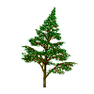


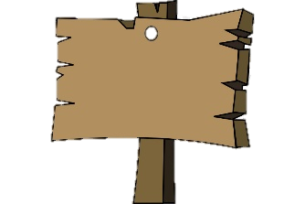

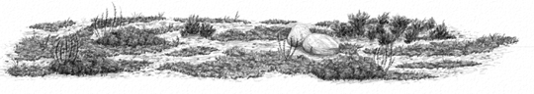
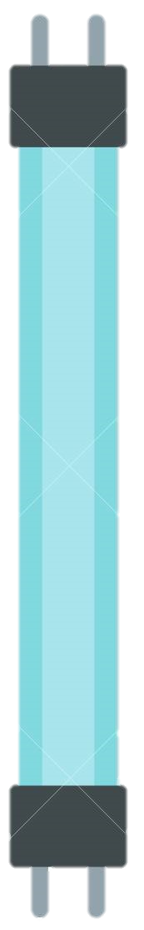

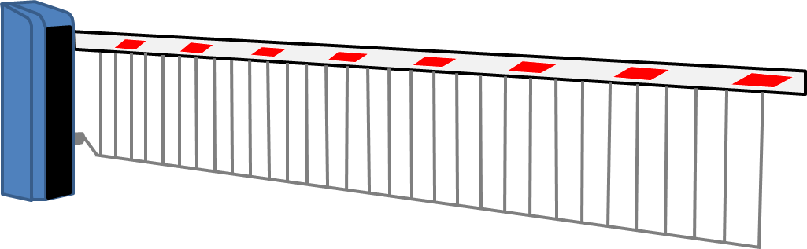


Caution
No moving objects such as flags or banners in the sensor’s detection area! Remove any vegetation from the detection area, or reconfigure the detection area to be smaller. Not following these recommendations may prevent the sensor to leave the detecting state or delay the change of the state.
Do not place an object such as a signboard close to the sensor's detection area. Sometimes the sensor may not leave detecting state or it may take a long time to become non-detecting after the vehicle leaves.
There should not be irregularity on the ground in the sensor's detection area. Sometimes the sensor may not leave detecting status or it may take a long time to become non-detecting after the vehicle leaves.
Do not use a fluorescent lamp around the detection area. It may prevent proper operation of the sensor.
A barrier arm with a skirt or sign may cause unstable detection by the sensor. In such a case, detach or move the placard. Worst case: relocate sensor (away from the barrier arm).

Slide 21
Preparation
1 Loosen the retaining screws on the bottom of the front cover and remove the front cover.
2 To detach the sensor unit, hold here and pull out.

Slide 22
Mounting
Drill the holes. Route the cable.
Attach the base to the mounting surface using 4 screws.
High performance double sided sticky tape may be used as well.

Slide 23
Wiring
5 Connect the wires to the terminals.
Power Output
+ -
Input → see additional explanations
Relay output
NO / NC switchable
30 VDC 0.3 A or less (resistance load)
Power supply 12 – 24 VDC

Slide 24
Wiring
6 Push the sensor unit back into the case. Push the excess wire (≥ 10 cm) back into the mounting surface.

Slide 25
Set-up
Rotate the sensor unit to the correct angle.
90°
± 10°
< 45°

Slide 26
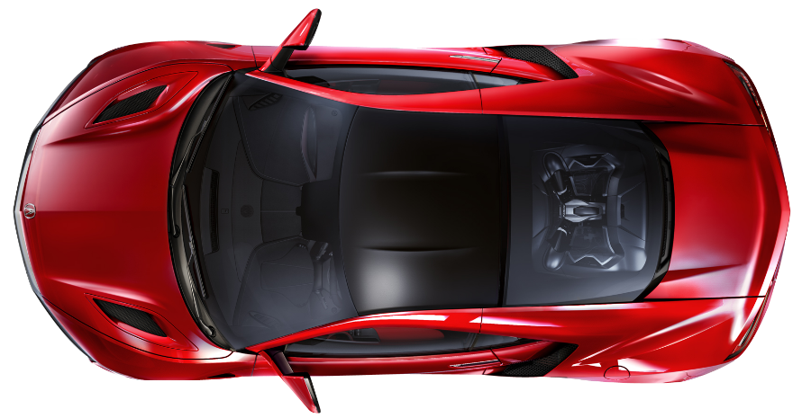
Hint
Perpendicular Mode
(Vehicle Protection Mode):
Less than ±5 degree
Not Recommended
Basically perpendicular
Recommended

Slide 27
Hint
Angled Mode (Activation Mode): Less than 45 degree to direction of car
Not Recommended
Recommended
Original angle

Slide 28
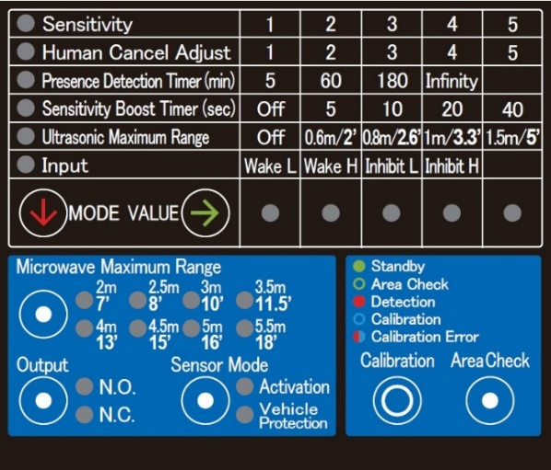
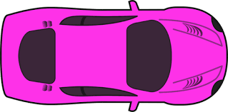
Configuration
Factory setting:
Perpendicular
Configure the proper sensor mode by pressing and holding the Sensor Mode button for 2 seconds.
Sensor Mode:
Perpendicular (Vehicle Protection)
Sensor Mode:
angled (Activation)
Notes:
Switch on power before this step

Slide 29
Configuration
Factory setting:
3.5 m
Adjust the detection range by pressing the Microwave Maximum Range button.
→ Set the range 500 mm shorter than the actual width of the road!
≥ 500 mm
Range

Slide 30
Calibration (memorizes the background of the detection area)
→ perform without any
pedestrians or vehicle
present!
Press and hold the Calibration button on the sensor unit
for 2 seconds.
The LED first blinks slowly for 8 seconds (leave detection area) and then blinks quickly for 2 seconds (calibration).
When the calibration is complete, the LED turns to a solid
green.
…
If the ultrasonic sensor detects an object during calibration,
the LED blinks in red and blue alternately.
→ calibration error.
If the cause cannot be eliminated reduce the range.
…

Slide 31
Calibration (memorizes the background of the detection area)
→ perform without any
pedestrians or vehicle
present!
...
The calibration must be performed again,
if a noticeable changes occurs around the detection area (such as construction of a wall or fence).
If a vehicle or pedestrian enters the detection area during the calibration.
If a change is made to the sensor such as
installation height,
direction angle
and/or microwave maximum range.

Slide 32
Detection area check
Can be performed after calibration.
Press the Area Check button → LED blinks green.
→Walk test the area
If the sensor detects you, then the LED lights up:
Blinking yellow: only the microwave sensor is detecting
Blinking purple: only the ultrasonic sensor is detecting
Blinking red: both the microwave and the ultrasonic are detecting

Slide 33

Detection area check
Stand at the centre of the vehicle lane and walk in the direction of the vehicle access.
When the LED turns from (slow) green blinking (non-detection) to fast red blinking (detecting), it is the edge of the detection area;
when coming closer it might turn to purple or red see table below.
Barrier open

Slide 34
Detection area check
Stand at the edge of the vehicle lane and walk along the edge.
Verify that the LED keeps blinking (slow) green (not detecting).
After verifying the detection area, press the Area Check button again!
Barrier arm
Barrier closed

Slide 35
Set-up
Factory setting:
N.O.
Select the output logic type by pressing the Output button.

Slide 36
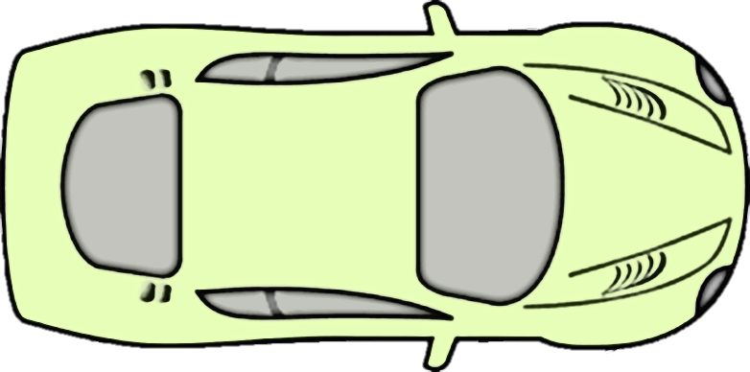
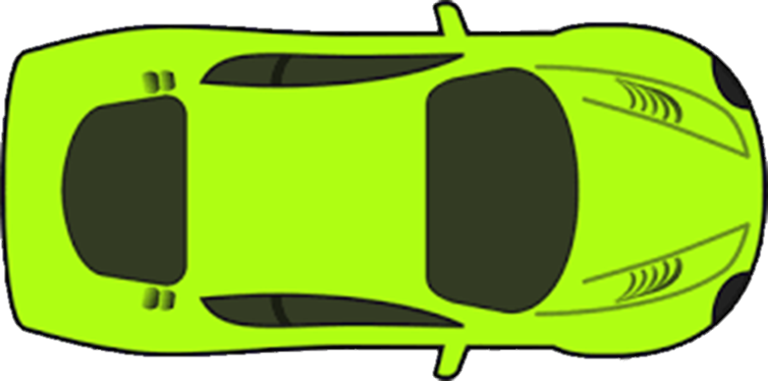
System operation check
After verifying the detection area, check the entire system using a vehicle.
For this purpose approach with a vehicle over the full width of the driveway.

Slide 37
Advanced settings

Slide 38
Advanced settings
Factory setting:
3
These parameters are to be adjusted if the sensor does not operate as expected.
They are not necessary for a normal installation.
Sensitivity to initial detection (Human Cancel Adjust)
Increase if : A person is detected occasionally
The sensor detects a vehicle passing close to (but not in) the detection area
Decrease if : Occasionally a vehicle is not detected
Response of detection is too slow
Note: If level is set to 1, vehicles and people will be detected (almost no people suppression anymore).
Setting
1
2
3
4
5
People suppression
capability
Low
High

Slide 39
Advanced settings
Factory setting:
3
These parameters are to be adjusted if the sensor does not operate as expected.
They are not necessary for a normal installation.
Sensitivity to static objects (after initial detection)
Increase if : Occasionally a vehicle is not detected over its full length
Decrease if : The sensor stays in detection after a vehicle has left
Note: If level is set to 5, both people and vehicles will be detected (no people suppression anymore).
Setting
1
2
3
4
5
Vehicle detection
capability
Low
High

Slide 40
Advanced settings
Factory setting:
5 min.
These parameters are to be adjusted if the sensor does not operate as expected.
They are not necessary for a normal installation.
Presence timer
Performs re-calibration after selected time (and assimilates object to the background)
Prevents the sensor from permanently staying in detection state
To be configured if:
The sensor stays in detection due to an object in the detection area

Slide 41
Advanced settings
Factory setting:
5 min.
These parameters are to be adjusted if the sensor does not operate as expected.
They are not necessary for a normal installation.
Presence timer
Description
An object is placed in the detection field of the microwave area and the detector detects the object.
When the time period of the presence timer runs down, the sensor changes to non-detection state because the object is memorized as a background.
When the object is removed, the sensor may stay in a non-detection or detection state. - If the sensor stays in the non-detection state, it may be less sensitive for a while.
When the object is removed after the time period of presence detection, the sensor will memorize again the background and be in non-detection state.

Slide 42
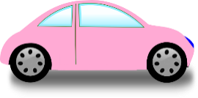
Advanced settings
Factory setting:
Off
These parameters are to be adjusted if the sensor does not operate as expected.
They are not necessary for a normal installation.
Sensitivity boost (Use only with perpendicular mode)
The sensitivity boost timer enhances the sensitivity for a certain period of time after a vehicle has passed through the detection area. Enable this function if a vehicle may back up unintentionally due to an slope in the exit area.
While the sensitivity boost timer is enabled, a human or an object other than a vehicle may be detected.
The function cannot be used for a gate system without a reopen function.
Barrier arm reopens
to prevent a contact

Slide 43
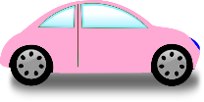
Advanced settings
Factory setting:
Off
These parameters are to be adjusted if the sensor does not operate as expected.
They are not necessary for a normal installation.
Sensitivity boost (Use only with perpendicular mode)
Sensitivity boost off on
Threshold
Signal
Output

Slide 44
Advanced settings
Factory setting:
1 m
These parameters are to be adjusted if the sensor does not operate as expected.
They are not necessary for a normal installation.
Ultrasonic range
If requested, adjust the ultrasonic sensor range:
Press the MODE button and select Ultrasonic Maximum Range
Press the VALUE button and select the desired sensing distance
After 30 seconds without detection the sensor automatically changes back to the normal operation mode.

Slide 45
Additional explanations

Slide 46
Heater
Built-in heater
For the ultrasonic module
When it gets colder (<5 °C), the heater automatically switches on to warm up the module
It can also melt accumulated snow on the surface of the module
→ Allows to use ProAccess down to -30° C

Slide 47
Input (terminals 5 and 6)
Factory setting:
Wake L
Possibility to trigger a sensitivity enhancement (Wake) by an external signal
i.e. the sensor will react to anything (similar to human cancel = off)
Possibility to inhibit the sensor (Inhibit) by an external signal
Use dry contact to activate
Umax = 5Vdc, Imax = 0.5mA, Uth = 0.75V (internal 10kOhm => Rmax <1.8kOhm)
Activation of input cannot be seen from outside
(e.g. with inhibit: algorithm continues to work and LED to change state, but output stays off)
Power Output Input
Signal GND

Slide 48
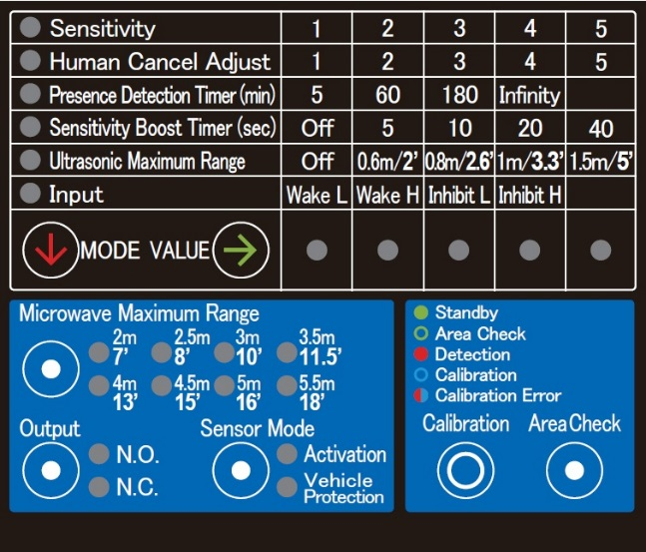
To get more accuracy…
Use two devices ProAccess (perpendicular mode)
Factory default setting
Adjust depending on site

Slide 49
Swing gate application (activation)
Use inhibit signal when gate is moving!
Factory default setting
Recommended setting
Adjust depending on site

Slide 50
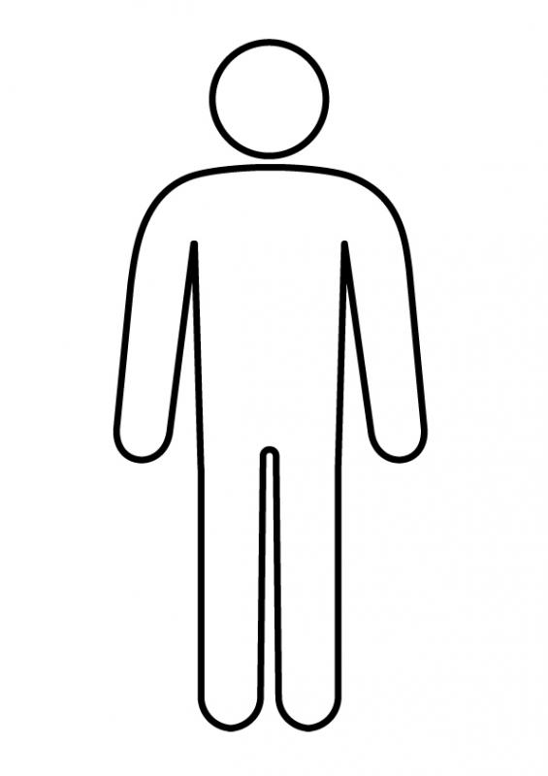
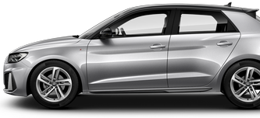
Mounting height
Why do we recommend a mounting height of 500 mm?
Moving detection (human cancel) is ignoring small objects.
Portion of body is big.
Portion of legs is small.
Mounted higher → higher probability of unintentionally detecting people.

Slide 51
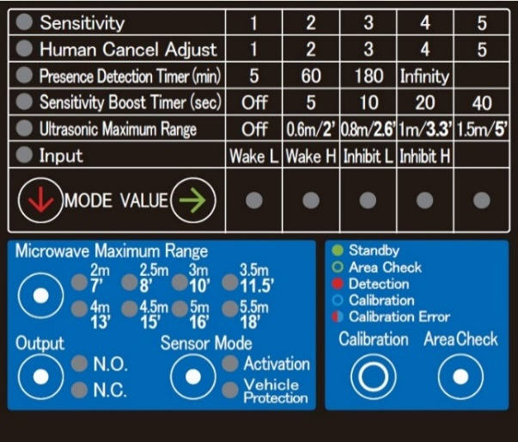
Troubleshooting (LED colours)
LED colour | Solid / blinking | Mode | Indication
green | solid | Standard operation | Standby
green | blinking twice | Standard operation | Error
green | blinking | Detection Area Check | Outside detection area
yellow | blinking | Detection Area Check | Within microwave detection area
yellow | solid 2 s | Factory reset | Reset completed
red | solid | Standard operation | Detection
red | blinking | Detection Area Check | Within microwave & ultrasonic detection area
purple | blinking | Detection Area Check | Within ultrasonic detection area
blue | blinking slowly | Calibration | Preparation → leave detection area!
blue | blinking fast | Calibration | Calibrating
blue - red | alternate blinking | Calibration | Ultrasonic sensor detection error

Slide 52
Troubleshooting (LED)
LED blinking green twice per 10 seconds
  Shows an unsuitable environment notification.
  Presence of a large metal object (e.g. shutter) in the front of the sensor can affect the microwave performance: the sensor may become unstable.
  → Check if there is a large metal object in front of the sensor and place it as far as possible from the sensor.
  Note: even if the LED blinks green, this does not automatically mean that the sensor is operating in an unstable way.

Slide 53
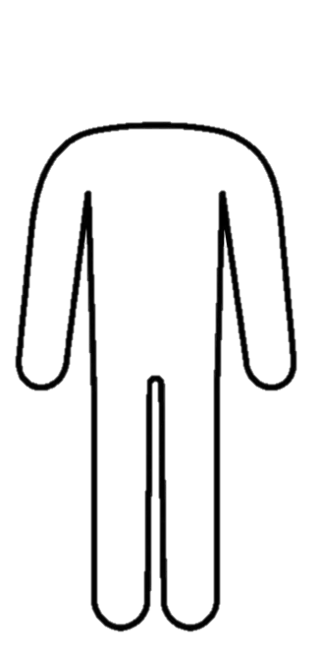

Trobleshooting (false triggers)
Note: If the total mass becomes similar to a vehicle, people can be detected.

Slide 54
Troubleshooting (False triggers)
Remove cover to see LED, though results might not be exactly the same
Get help from 2nd person to check LED(s)
Try different angles (possibly outside suggested angle)
Together with owner balance well between false triggers and missing detections
FYI: most barriers have a close timer e.g. 90s in case the presence signal was missed
and 2nd trial for approach/free exit sensor and card reader typically acceptable

Slide 55
Other recommendations
Get yourself accustomed to removing and reinstalling cover.
Allow (yourself) time to find the right setting(s):
it might take several days to determine if a change resulted with relevant improvements.
Possibly use mechanical structures (e.g. soft pole) to direct/slow? vehicles toward desired detection
Sensor will not react to fwd/bwd traffic
(will only react to left/right movements opposed to loop which cannot tell direction)
Weather might change behaviour slightly (possibly similar to “Klever” effect)

Slide 56

Factory reset
Press and hold both the Calibration button and Area Check button at the same time for 2 seconds.

